Slide 1
Unit 6
Wireless Network Security

Slide 2
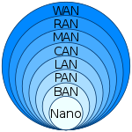
Wireless LAN
A type of local area network that uses radio waves to connect devices such as laptops, smartphones, tablets, and other wireless-enabled devices to the internet and to each other.
Widely used in homes, businesses, and public spaces due to their flexibility, convenience, and ease of installation.

Slide 3
Nanoscale
Near-field (NFC)
Body
Personal (PAN)
Near-me
Local (LAN)
Storage (SAN)
Wireless (WLAN)
Virtual (VLAN)
Home (HAN)
Building
Campus (CAN)
Backbone
Metropolitan (MAN)
Municipal wireless (MWN)
Wide (WAN)

Slide 4
Types of Wireless LAN
IEEE 802.11 has two basic modes of operations:
Infrastructure Mode (Wireless Access Point)
Ad-Hoc Mode (Peer-to-Peer)

Slide 5
IEEE 802.11 Wireless LAN
A set of standards developed by the Institute of Electrical and Electronics Engineers (IEEE) for implementing wireless local area network (WLAN) communications.
These standards specify the protocols that enable wireless networking devices to communicate with each other, typically within a local area such as a home, office, or campus.
The term 802.11x is also used to denote the set of standards. Various specifications and amendments include 802.11a, 802.11b, 802.11e, 802.11g, 802.11n etc

Slide 6
Components of IEEE 802.11
Standards and Amendments (802.11 n)
Frequency Bands (2.4 GHz and 5 GHz)
Modulation Techniques
(Orthogonal Frequency-Division Multiplexing – OFDM and Direct Sequence Spread Spectrum - DSSS)
Security Protocols (WEP, WPA and WPA n)
Network Architectures

Slide 7
Important Terminologies in IEEE 802.11
Station (STA)
Wireless Access Point (WAP)
Client
Access Point
Distributed System
Frame
Service Set Identifier (SSID)
Network Interface Controller (NIC)
Portal

Slide 8
802.11a: High data rate (54 Mbps), 5 GHz band, short range, less interference.
802.11b: Lower data rate (11 Mbps), 2.4 GHz band, longer range, more interference.
802.11e: QoS enhancements for latency-sensitive applications, works with other standards.
802.11g: Combines higher data rate (54 Mbps) of 802.11a with 2.4 GHz band of 802.11b, prone to interference.
802.11n: High data rate (up to 600 Mbps), dual-band, improved range and reliability with MIMO, backward compatibility with a/b/g.

Slide 9
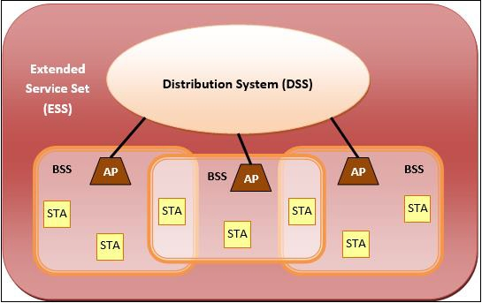
IEEE 802.11 Architecture

Slide 10
Advantages v/s Disadvantages of WLAN

Slide 11
IEEE 802.11i
Also known as WPA2 (Wi-Fi Protected Access II), is an amendment to the original IEEE 802.11 standard that enhances security for wireless local area networks (WLANs)
It is significant improvements over the previous security protocols, particularly WEP (Wired Equivalent Privacy) and WPA (Wi-Fi Protected Access)

Slide 12
Key Features of IEEE 802.11i
Enhanced Encryption
AES
Counter Mode with Cipher Block Chaining Message Authentication Code Protocol – CCMP
Authentication Mechanisms
802.1X Authentication
Extensible Authentication Protocol - EAP,
EAP Transport Layer - EAP-TLS,
EAP Tunneled Transport Layer Security - EAP-TTLS and
Protected EAP - PEAP
Pre-Shared Key (PSK) Mode

Slide 13
Key Management
Temporal Key Integrity Protocol (TKIP)
Key Distribution
Data Integrity and Replay Protection
Message Integrity Check (MIC)
Backward Compatibility
WPA2

Slide 14
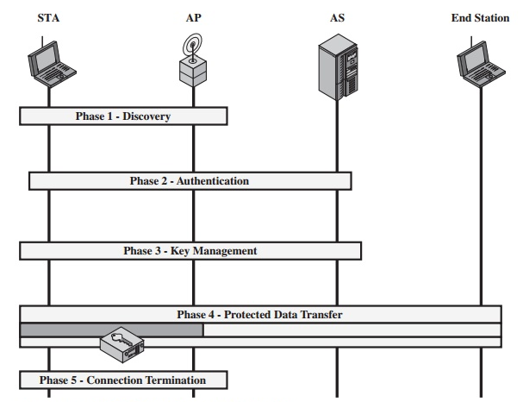
Phases of Operations
Network Discovery
Authentication Phase
Key Management Phase
Encryption Phase
Data Transmission Phase

Slide 15
Discovery
An AP uses messages called Beacons and Probe Responses to advertise its IEEE 802.11i security policy.
The STA uses these to identify an AP for a WLAN with which it wishes to communicate.
The STA associates with the AP, which it uses to select the cipher suite and authentication mechanism when the Beacons and Probe Responses present a choice.

Slide 16
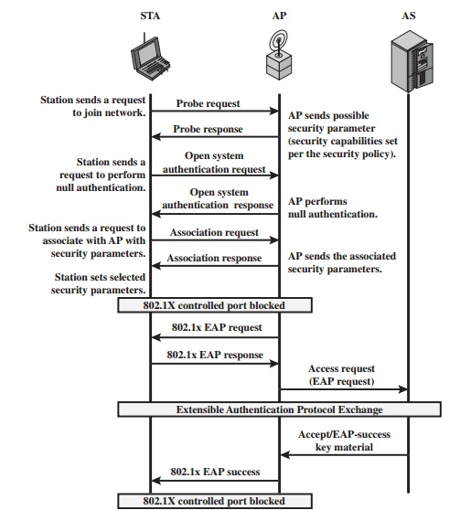

Slide 17
Authentication
The STA and AS prove their identities to each other.
The AP blocks non-authentication traffic between the STA and AS until the authentication transaction is successful.
The AP does not participate in the authentication transaction other than forwarding traffic between the STA and AS.

Slide 18
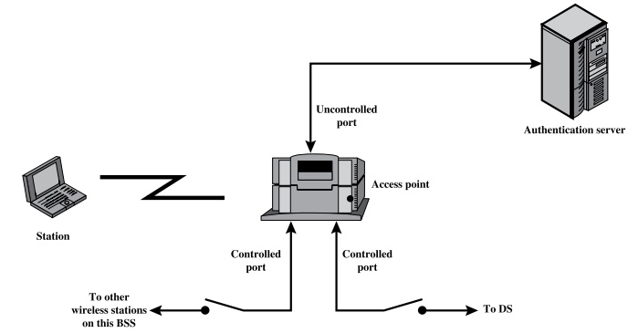

Slide 19
Key Generation and Distribution
The AP and the STA perform several operations that cause cryptographic keys to be generated and placed on the AP and the STA.
Frames are exchanged between the AP and STA only.

Slide 20
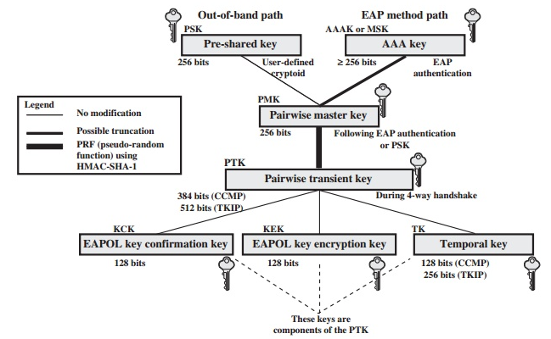
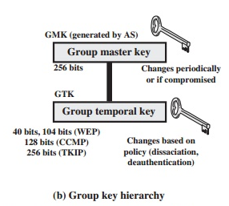

Slide 21
Protected data transfer
Frames are exchanged between the STA and the end station through the AP.
As denoted by the shading and the encryption module icon, secure data transfer occurs between the STA and the AP only; security is not provided end-to-end.

Slide 22
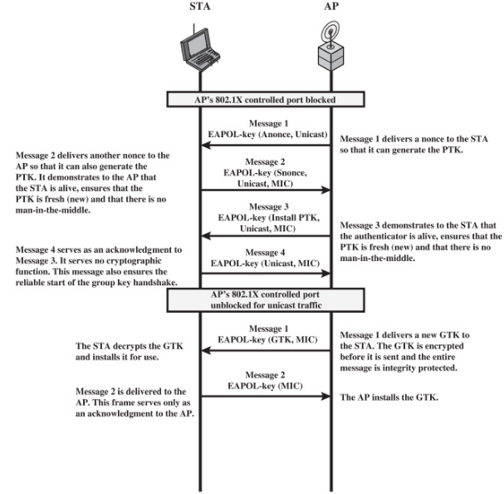
Four way handshake and Group key handshake

Slide 23
Connection Termination
The AP and STA exchange frames.
The secure connection is torn down and the connection is restored to the original state.

Slide 24
Wireless Application Protocol
A set of communication protocols and an application programming model based on the World Wide Web (WWW)
A protocol designed for micro-browsers and it enables access to the internet in mobile devices
It uses the markup language WML (Wireless Markup Language and not HTML), WML is defined as an XML 1.0 application

Slide 25
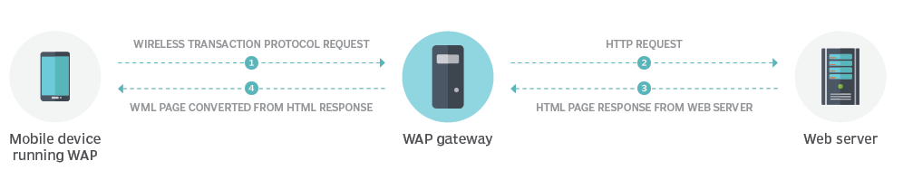
A protocol suite designed to create interoperability between WAP equipment, such as mobile phones that use the protocol, and WAP software, such as WAP-enabled web browsers and network technologies

Slide 26
WAP Model
The user opens the mini-browser in a mobile device. He selects a website that he wants to view.
The mobile device sends the URL encoded request via network to a WAP gateway using WAP protocol.

Slide 27
The WAP gateway translates this WAP request into a conventional HTTP URL request and sends it over the internet.
The request reaches to a specified web server and it processes the request just as it would have processed any other request and sends the response back to the mobile device through WAP gateway in WML file which can be seen in the micro-browser.

Slide 28
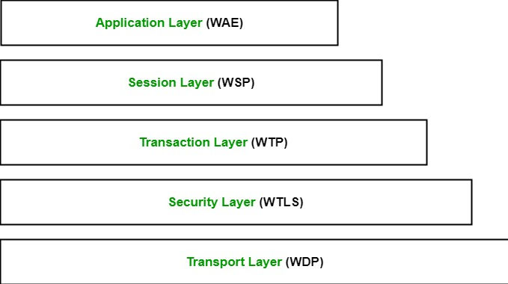
WAP Protocol Stack

Slide 29
WAP Protocol Stack
Application Layer (WAE):
Manages the user interface and content rendering.
Uses WML and WMLScript for creating interactive applications.
Session Layer (WSP):
Manages sessions between the client and the server.
Provides connection-oriented and connectionless session services.

Slide 30
Transaction Layer (WTP):
This layer contains Wireless Transaction Protocol (WTP).
It runs on top of UDP (User Datagram Protocol) and is a part of TCP/IP and offers transaction support.
Security Layer (WTLS):
This layer contains Wireless Transport Layer Security (WTLS).
It offers data integrity, privacy and authentication.

Slide 31
Transport Layer (WDP):
WTLS: Ensures secure data transfer with encryption and authentication.
WDP: Facilitates data transfer over different bearer networks like SMS, GPRS, and more.

Slide 32
Evolution of WAP
WAP 1.0:
The initial version, focused on providing basic mobile internet access.
WAP 2.0:
Introduced enhancements like support for XHTML Mobile Profile (XHTML-MP), bringing it closer to standard web technologies and improving compatibility with existing web content.

Slide 33
Advantages v/s Disadvantages of WAP

Slide 34
Why to use WAP

Slide 35
Wireless Transport Layer Security
provide privacy, data integrity and authentication between applications communicating using WAP
part of the Wireless Application Protocol (WAP) suite and serves a similar role to the Transport Layer Security (TLS) protocol used in wired networks
WTLS is optimized for the constraints of wireless networks, such as lower bandwidth, higher latency, and limited processing power of mobile devices

Slide 36
Features
Data Encryption
Data Integrity
Authentication
Compression
Session manager

Slide 37
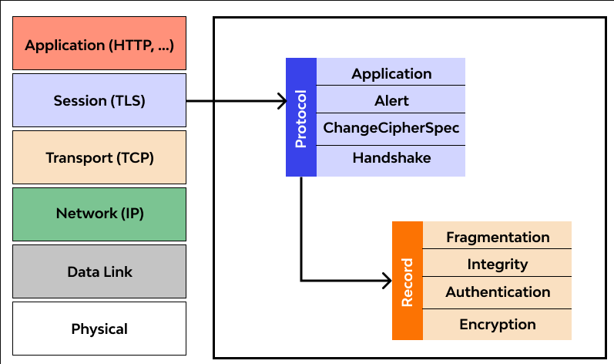
Protocol Layers
Record Layer
Handshake Protocol
Alert Protocol
Change Cipher spec Protocol

Slide 38
Advantages v/s Disadvantages of WTLS

Slide 39
WTLS v/s TLS

Slide 40
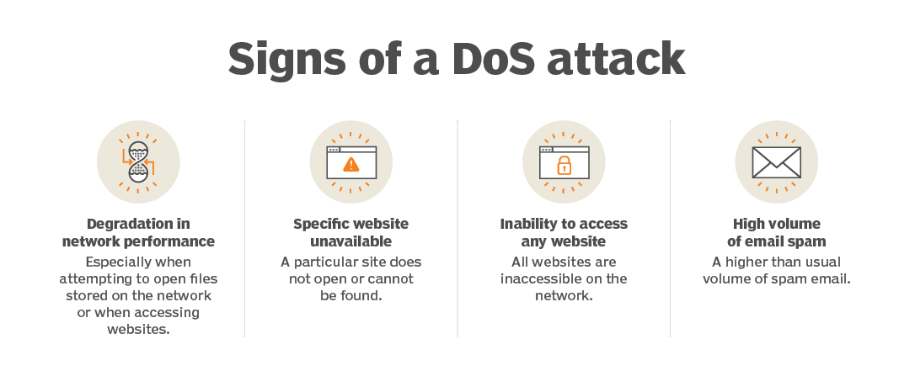
Detects and Rejects DOS attack

